Slide 1

DEliVERiNGSKiLLS
DRiViNGSUCCESS
www.VINSYS.COM

Slide 2
Database Objects

Slide 3
Database Objects
Object | Description
Table | Basic unit of storage; composed of rows and columns
View | Logically represents subsets of data from one or more tables
Sequence | Numeric value generator
Index | Improves the performance of some queries
Synonym | Gives alternative names to objects

Slide 4
Table
It is basic unit of database
It is used to store data
Structure of table must be specified before inserting records in it
Records are stored inside table in rows & columnar format.

Slide 5
Naming Rules
Table names and column names:
Must begin with a letter
Must be 1–30 characters long
Must contain only A–Z, a–z, 0–9, _, $, and #
Must not duplicate the name of another object owned by the same user
Must not be an Oracle server reserved word

Slide 6
The CREATE TABLE Statement
You must have:
– CREATE TABLE privilege
– A storage area
CREATE TABLE [schema.]table
(column datatype [DEFAULT expr][, ...]);

Slide 7
Creating Tables
CREATE TABLE dept (deptno NUMBER(2),
dname VARCHAR2(14),
loc VARCHAR2(13));

Slide 8
Tables in the Oracle Database
User Tables:
– Are a collection of tables created and maintained by the user
– Contain user information
Data Dictionary:
– Is a collection of tables created and maintained by the Oracle Server
– Contain database information

Slide 9
Querying the Data Dictionary
See the names of tables owned by the user.
SELECT table_name FROM user_tables ;

Slide 10
Data Types
Data Type | Description
VARCHAR2(size) | Variable-length character data
CHAR(size) | Fixed-length character data
NUMBER(p,s) | Variable-length numeric data
DATE | Date and time values
LONG | Variable-length character data up to 2 gigabytes
CLOB | Character data up to 4 gigabytes
RAW and LONG RAW | Raw binary data
BLOB | Binary data up to 4 gigabytes
BFILE | Binary data stored in an external file; up to 4 gigabytes
ROWID | A 64 base number system representing the unique address of a row in its table.

Slide 11
Data Types (continued)
Data Type | Description
RAW(size) | Raw binary data of SIZE (max SIZE must be specified. Max SIZE is 2000
LONG RAW | Raw binary data of variable length up to 2 gigabytes
BLOB | Binary data up to 4 gigabytes
BFILE | Binary data stored in an external file; up to 4 gigabytes
ROWID | A 64 base number system representing the unique address of a row in its table.

Slide 12
DateTime Data Types
Accepts date & stores it in NUMERIC FORMAT internally.
New Datetime data types have been introduced.
Example:-
CREATE TABLE T1 (no number, hiredate date);

Slide 13
Datetime Datatype
Data Type | Description
TIMESTAMP | Date with fractional seconds
INTERVAL YEAR TO MONTH | Stored as an interval of years and months
INTERVAL DAY TO SECOND | Stored as an interval of days to hours minutes and seconds

Slide 14
DateTime Data Types
The TIMESTAMP data type is an extension of the
DATE data type.
It stores the year, month, and day of the DATE
data type, plus hour, minute, and second values as well as the fractional second value.
The TIMESTAMP data type is specified as follows:
TIMESTAMP[(fractional_seconds_precision)]

Slide 15
TIMESTAMP WITH TIME ZONE Data Type
TIMESTAMP WITH TIME ZONE is a variant of
TIMESTAMP that includes a time zone displacement in its value.
The time zone displacement is the difference, in
hours and minutes, between local time and UTC.
TIMESTAMP[(fractional_seconds_precision)]
WITH TIME ZONE

Slide 16
TIMESTAMP WITH LOCAL TIME Data Type
TIMESTAMP WITH LOCAL TIME ZONE is another
variant of TIMESTAMP that includes a time zone
displacement in its value.
Data stored in the database is normalized to the database time zone.
The time zone displacement is not stored as part
of the column data; Oracle returns the data in the
users’ local session time zone.
TIMESTAMP WITH LOCAL TIME ZONE data type is
specified as follows:
TIMESTAMP[(fractional_seconds_precision)]
WITH LOCAL TIME ZONE

Slide 17
Creating a Table by Using a Subquery Syntax
Create a table and insert rows by combining the
CREATE TABLE statement and the AS subquery option.
Match the number of specified columns to the
number of subquery columns.
Define columns with column names and default values.
CREATE TABLE table
[(column, column...)]
AS subquery;

Slide 18
Example
CREATE TABLE dept20
AS
SELECT empno, ename,sal*12 Annsal, hiredate
FROM emp
WHERE deptno= 20;

Slide 19
The ALTER TABLE Statement
Use the ALTER TABLE statement to:
• Add a new column
• Modify an existing column
• Define a default value for the new column
• Drop a column

Slide 20
The ALTER TABLE Statement
Use the ALTER TABLE statement to add, modify, or
drop columns.
ALTER TABLE table ADD (column datatype [DEFAULT expr]
[, column datatype]...);
ALTER TABLE table MODIFY (column datatype [DEFAULT expr][, column datatype]...);
ALTER TABLE table
DROP (column);

Slide 21
Adding a Column
ALTER TABLE dept80 ADD (job_id VARCHAR2(9));
DROPPING COLUMN
ALTER TABLE dept80 DROP COLUMN job_id;

Slide 22
MODIFYING a COLUMN
ALTER TABLE dept80
MODIFY (last_name VARCHAR2(30));
You can change a column’s data type, size, and
default value.
A change to the default value affects only
subsequent insertions to the table.

Slide 23
The SET UNUSED Option
You use the SET UNUSED option to mark one or more columns as unused.
You use the DROP UNUSED COLUMNS option to remove the columns that are marked as unused.
ALTER TABLE table SET UNUSED (column);
OR
ALTER TABLE table SET UNUSED COLUMN column;

Slide 24
Renaming Object
To change the name of a table, view, sequence, or synonym, you execute the RENAME statement
RENAME dept TO detail_dept;
You must be the owner of the object.

Slide 25
Dropping a Table
All data and structure in the table is deleted.
• Any pending transactions are committed.
• All indexes are dropped.
• You cannot roll back the
DROP TABLE statement.
DROP TABLE dept80;

Slide 26
Truncating a Table
The TRUNCATE TABLE statement:
– Removes all rows from a table
– Releases the storage space used by that table
TRUNCATE TABLE detail_dept;
You cannot roll back row removal when using TRUNCATE.
Alternatively, you can remove rows by using the
DELETE statement.

Slide 27
Creating Views

Slide 28
Database Objects
Object | Description
Table | Basic unit of storage; composed of rows and columns
View | Logically represents subsets of data from one or more tables
Sequence | Numeric value generator
Index | Improves the performance of some queries
Synonym | Gives alternative names to objects

Slide 29

VIEW

Slide 30
View
A View is logical table based on a base table or a view in turn.
A view contains no data of its own but is like a window through which data from tables can be viewed or changed.
The view is stored as a SELECT statement in the data dictionary.

Slide 31
Why Views ?
To restrict data access
To make complex queries easy
To provide data independence
To present different views of the same data

Slide 32
Types Of Views
Views
Simple Views
Complex Views

Slide 33
Simple Views and Complex Views
Feature | Simple views | Complex views
No. Of Tables | One | One or more
Contain Functions | No | Yes
Contain Groups Of Data | No | Yes
DML Operation Through a View | Yes | Not Always

Slide 34
Creating a View
You embed a subquery within the CREATE VIEW statement.
CREATE [OR REPLACE] [FORCE|NOFORCE] VIEW view [(alias[, alias]...)]
AS subquery
[WITH CHECK OPTION [CONSTRAINT constraint]]
[WITH READ ONLY [CONSTRAINT constraint]];

Slide 35
Creating a View Example
Create a view, EMPVU30, that contains details of
employees in department 30.
CREATE VIEW empvu80
AS SELECT empno, ename, sal
FROM emp
WHERE deptno= 30;
DESCRIBE empvu80

Slide 36
Creating a View By Using Aliases
CREATE VIEW salvu10 (ID_NUMBER, NAME, ANN_SAL)
AS SELECT empno, ename, sal*12
FROM emp
WHERE deptno= 10;
OR
CREATE VIEW salvu10
AS SELECT empno ID_NUMBER, ename NAME,
sal*12 ANN_SALARY
FROM emp
WHERE deptno = 10;

Slide 37
Modifying a View
There is no ‘ALTER VIEW’ command to modify a view.
You have to use ‘CREATE OR REPLACE VIEW view’

Slide 38
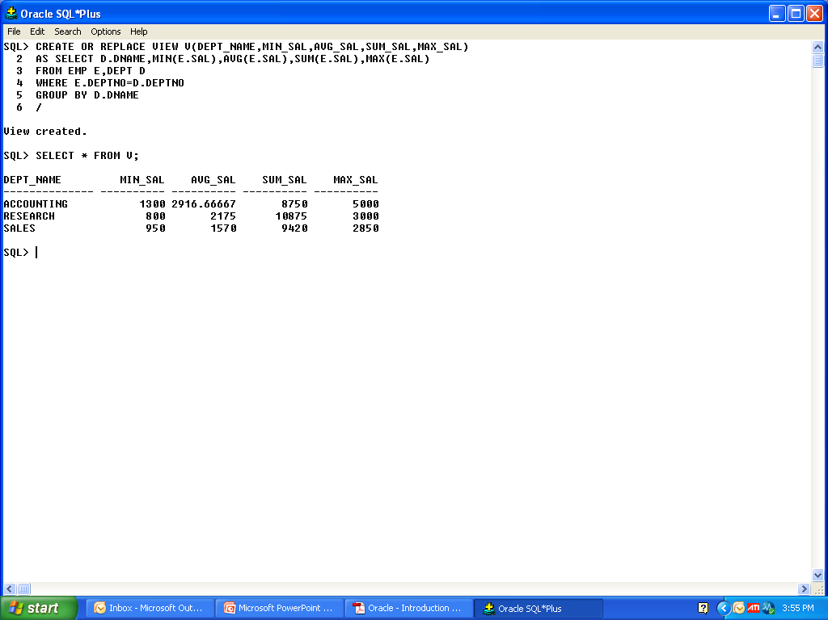
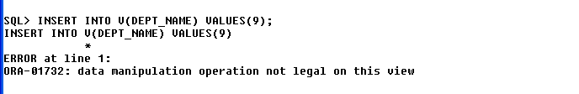
Creating Complex Views

Slide 39
Rules for Performing DML Operations on a View
• You can perform DML operations on simple views.
• You cannot remove a row if the view contains the
following:
– Group functions
– A GROUP BY clause
– The DISTINCT keyword
– The pseudocolumn ROWNUM keyword

Slide 40
Rules for Performing DML Operations on a View
You cannot modify data in a view if it contains:
Group functions
A GROUP BY clause
The DISTINCT keyword
The pseudocolumn ROWNUM keyword
Columns defined by expressions

Slide 41
Rules for Performing DML Operations on a View
You cannot add data through a view if the view
includes:
Group functions
A GROUP BY clause
The DISTINCT keyword
The pseudocolumn ROWNUM keyword
Columns defined by expressions
NOT NULL columns in the base tables that are not selected by the view

Slide 42
Using the WITH CHECK OPTION Clause
You can ensure that DML operations performed on the view stay within the domain of the view by using the WITH CHECK OPTION clause.
• Any attempt to change the department number for any row in the view fails because it violates the WITH CHECK OPTION constraint.
CREATE OR REPLACE VIEW empvu20
AS SELECT *
FROM emp
WHERE deptno= 20
WITH CHECK OPTION CONSTRAINT empvu20_ck ;

Slide 43
Denying DML Operations
You can ensure that no DML operations occur by adding the WITH READ ONLY option to your view definition.
Any attempt to perform a DML on any row in the view results in an Oracle server error.

Slide 44
Denying DML Operations
CREATE OR REPLACE VIEW empvu10
(empno, name, job)
AS SELECT empno, ename, job
FROM emp
WHERE deptno= 10
WITH READ ONLY;

Slide 45
Removing a View
DROP VIEW view;
Drop view V1;

Slide 46
Inline Views
An inline view is a subquery with an alias (or
correlation name) that you can use within a SQL statement.
A named subquery in the FROM clause of the main query is an example of an inline view.
An inline view is not a schema object.

Slide 47
Example
SELECT a.ename, a.sal, a.deptno, b.maxsal
FROM emp a, (SELECT deptno, max(sal) maxsal
FROM emp
GROUP BY deptno) b
WHERE a.deptno = b.deptno
AND a.sal< b.maxsal;

Slide 48
Other Database Objects

Slide 49
Other Database Objects
Object | Description
Table | Basic unit of storage; composed of rows and columns
View | Logically represents subsets of data from one or more tables
Sequence | Numeric value generator
Index | Improves the performance of some queries
Synonym | Gives alternative names to objects

Slide 50
Sequence
• Automatically generates unique numbers
• Is a sharable object
• Is typically used to create a primary key value
• Replaces application code
• Speeds up the efficiency of accessing sequence
values when cached in memory

Slide 51
Sequence
Define a sequence to generate sequential numbers automatically:
CREATE SEQUENCE sequence
[INCREMENT BY n]
[START WITH n]
[{MAXVALUE n | NOMAXVALUE}]
[{MINVALUE n | NOMINVALUE}]
[{CYCLE | NOCYCLE}]
[{CACHE n | NOCACHE}];

Slide 52
Sequence Example
CREATE SEQUENCE dept_deptid_seq
INCREMENT BY 10
START WITH 120
MAXVALUE 9999
NOCACHE
NOCYCLE;
Sequence created.

Slide 53
Using NEXTVAL and CURRVAL Pseudocolumns
NEXTVAL returns the next available sequence
value. It returns a unique value every time it is
referenced, even for different users.
CURRVAL obtains the current sequence value.
NEXTVAL must be issued for that sequence before CURRVAL contains a value

Slide 54
Sequence
INSERT INTO dept(deptno,dname, loc)
VALUES (dept_deptid_seq.NEXTVAL,’Support’, 2500);
SELECT dept_deptid_seq.CURRVAL
FROM dual;

Slide 55
Confirming Sequences
Verify your sequence values in the
USER_SEQUENCES data dictionary table
SELECT sequence_name, min_value, max_value,
increment_by, last_number
FROM user_sequences
The LAST_NUMBER column displays the next
available sequence number if NOCACHE is
specified.

Slide 56
Using a Sequence
Caching sequence values in memory gives faster
access to those values.
Gaps in sequence values can occur when:
– A rollback occurs
– The system crashes
– A sequence is used in another table
If the sequence was created with NOCACHE, view
the next available value, by querying the
USER_SEQUENCES table.

Slide 57
Modifying a Sequence
Change the increment value, maximum value,
minimum value, cycle option, or cache option.
ALTER SEQUENCE dept_deptid_seq
INCREMENT BY 20
MAXVALUE 999999
NOCACHE
NOCYCLE

Slide 58
Guidelines for Modifying a Sequence
You must be the owner or have the ALTER privilege for the sequence.
Only future sequence numbers are affected.
The sequence must be dropped and
re-created to restart the sequence at a different number.

Slide 59
Removing a Sequence
Remove a sequence from the data dictionary by using the DROP SEQUENCE statement.
Once removed, the sequence can no longer be referenced.
DROP SEQUENCE dept_deptid_seq

Slide 60
Indexes
An Index is –
Is a schema object
Is used by the Oracle server to speed up the
retrieval of rows by using a pointer
Can reduce disk I/O by using a rapid path access
method to locate data quickly
Is independent of the table it indexes
Is used and maintained automatically by the
Oracle server

Slide 61
How To Create Index
• Automatically: A unique index is created
automatically when you define a PRIMARY KEY or UNIQUE constraint in a table definition.
• Manually: Users can create indexes on columns to speed up access to the rows

Slide 62
Creating Index-
• Create an index on one or more columns.
CREATE INDEX index
ON table (column[, column]...);
• Improve the speed of query access to the
LAST_NAME column in the EMPLOYEES table.
CREATE INDEX emp_last_name_idx
ON emp (ename);
Index created.

Slide 63
When to Create an Index
You should create an index if:
A column contains a wide range of values
A column contains a large number of null values
One or more columns are frequently used together in a WHERE clause or a join condition
The table is large and most queries are expected to retrieve less than 2 to 4 percent of the rows

Slide 64
When Not to Create an Index
The table is small
The columns are not often used as a condition in
the query
Most queries are expected to retrieve more than 2 to 4 percent of the rows in the table
The table is updated frequently
The indexed columns are referenced as part of an
expression
Use USER_INDEXES or USER_IND_COLUMNS data dictionary views

Slide 65
Function-Based Indexes
A function-based index is an index based on expressions.
The index expression is built from table columns,
constants, SQL functions, and user-defined functions.
CREATE INDEX upper_dept_name_idx
ON departments(UPPER(department_name));
SELECT *
FROM departments
WHERE UPPER(department_name) = ’SALES’

Slide 66
Removing an Index
Remove an index from the data dictionary by
using the DROP INDEX command.
DROP INDEX index;
Remove the UPPER_LAST_NAME_IDX index from
the data dictionary.
DROP INDEX upper_last_name_idx;
Index dropped.
To drop an index, you must be the owner of the
index or have the DROP ANY INDEX privilege.

Slide 67
Synonyms
Simplify access to objects by creating a synonym
(another name for an object).
With synonyms, you can:
• Ease referring to a table owned by another user
• Shorten lengthy object names
CREATE [PUBLIC] SYNONYM synonym
FOR object

Slide 68
Creating and Removing Synonyms
• Create a shortened name for the DEPT_SUM_VU view.
CREATE SYNONYM d_sum
FOR dept_sum_vu;
Synonym Created.
Drop a synonym.
DROP SYNONYM d_sum;
Synonym dropped.

Slide 69
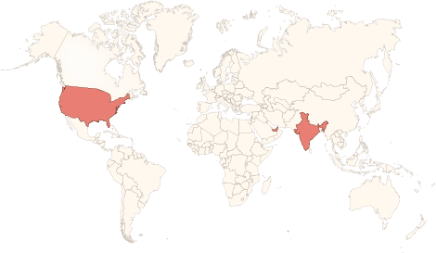






Physical Presence
www.vinsys.com
enquiry@vinsys.com
Shivaji Niketan, Tejas Society, Behind Kothrud Bus Stand, Near Mantri Park, Kothrud, Pune - 411029.
304, City Tower 2, Near Crown Plaza, Sheikh Zayed Road. Dubai, UAE.
PO.Box - 213279
132 West 31st Street, First Floor, New York, 10001, USA

